Slide 1


Energy Management Project
Feasibility Study of CHP and Wind Power Systems
Lorenzo Mascia

Slide 2
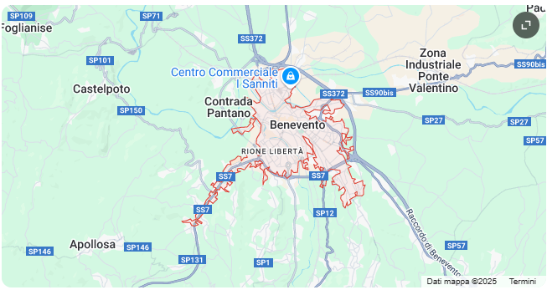
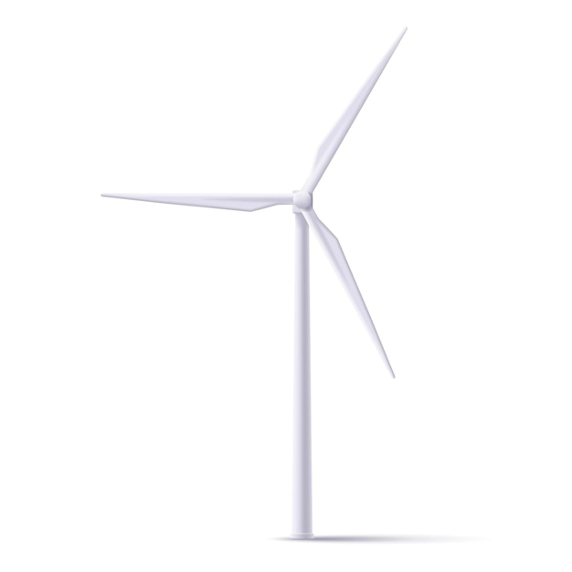
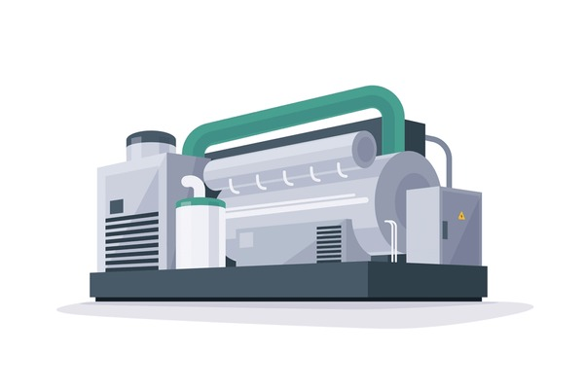
Introduction
Feasibility study for an energy system combining CHP (Combined Heat and Power) and wind power.
Location: Benevento, Italy.
Optimization based on investment costs, turbine height, electrical power, and gas engine efficiency.
Goal: Achieve favorable technical and economic indicators.

Slide 3
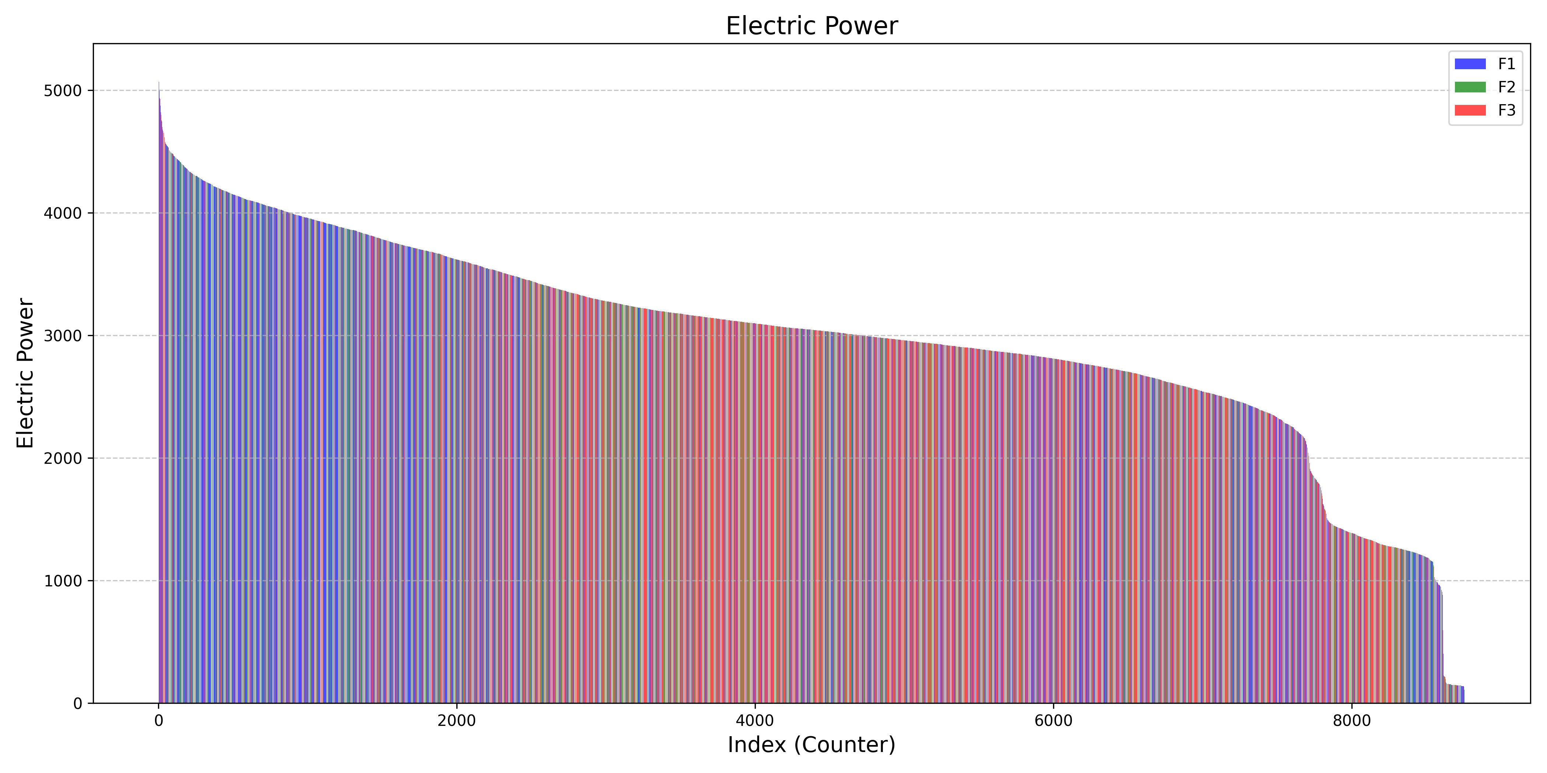
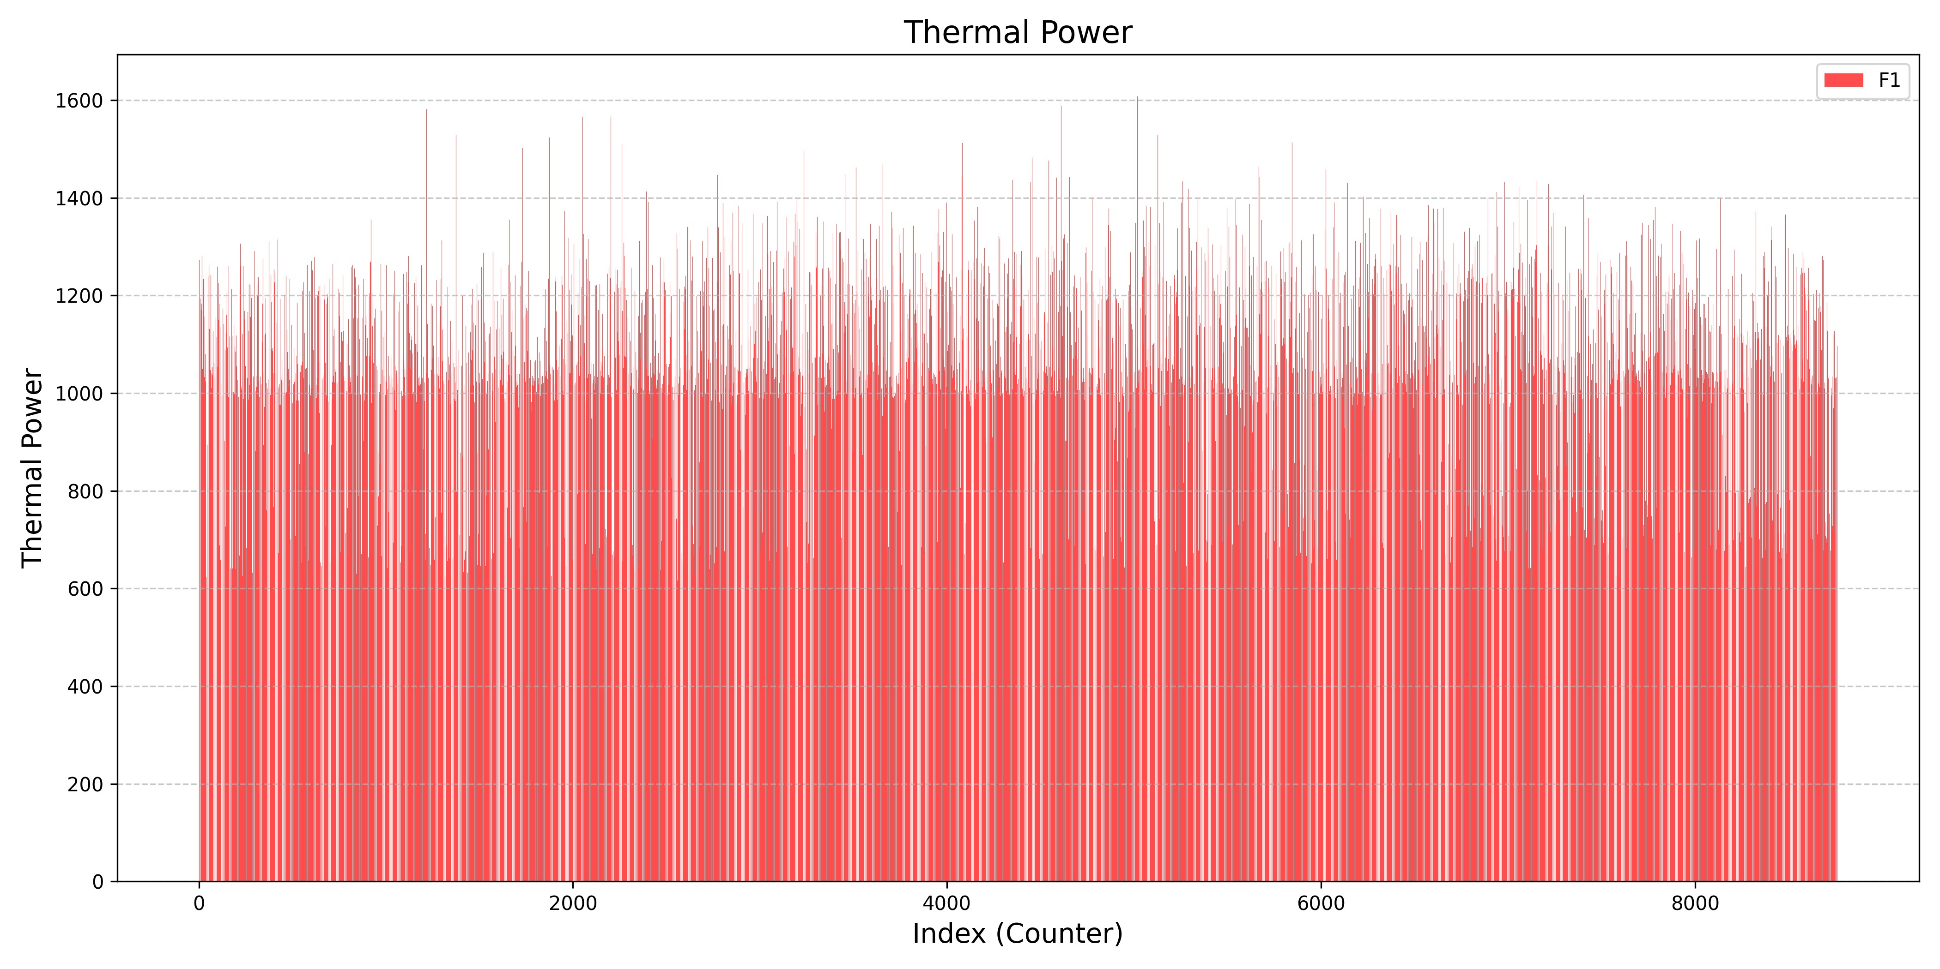
User Load Analysis
Electrical power load
Analysis of hourly electrical and thermal power loads.
Thermal load consistently above 600 kW.
Thermal power load
CHP to provide thermal load, wind turbines to cover additional energy needs.

Slide 4
User Load Analysis
Electrical power load
Analysis of hourly electrical and thermal power loads.
Thermal load consistently above 600 kW.
Thermal power load
CHP to provide thermal load, wind turbines to cover additional energy needs.

Slide 5
User Load Analysis
Thermal power load
Electrical power load
Analysis of hourly electrical and thermal power loads.
Thermal load consistently above 600 kW.
CHP to provide thermal load, wind turbines to cover additional energy needs.

Slide 6
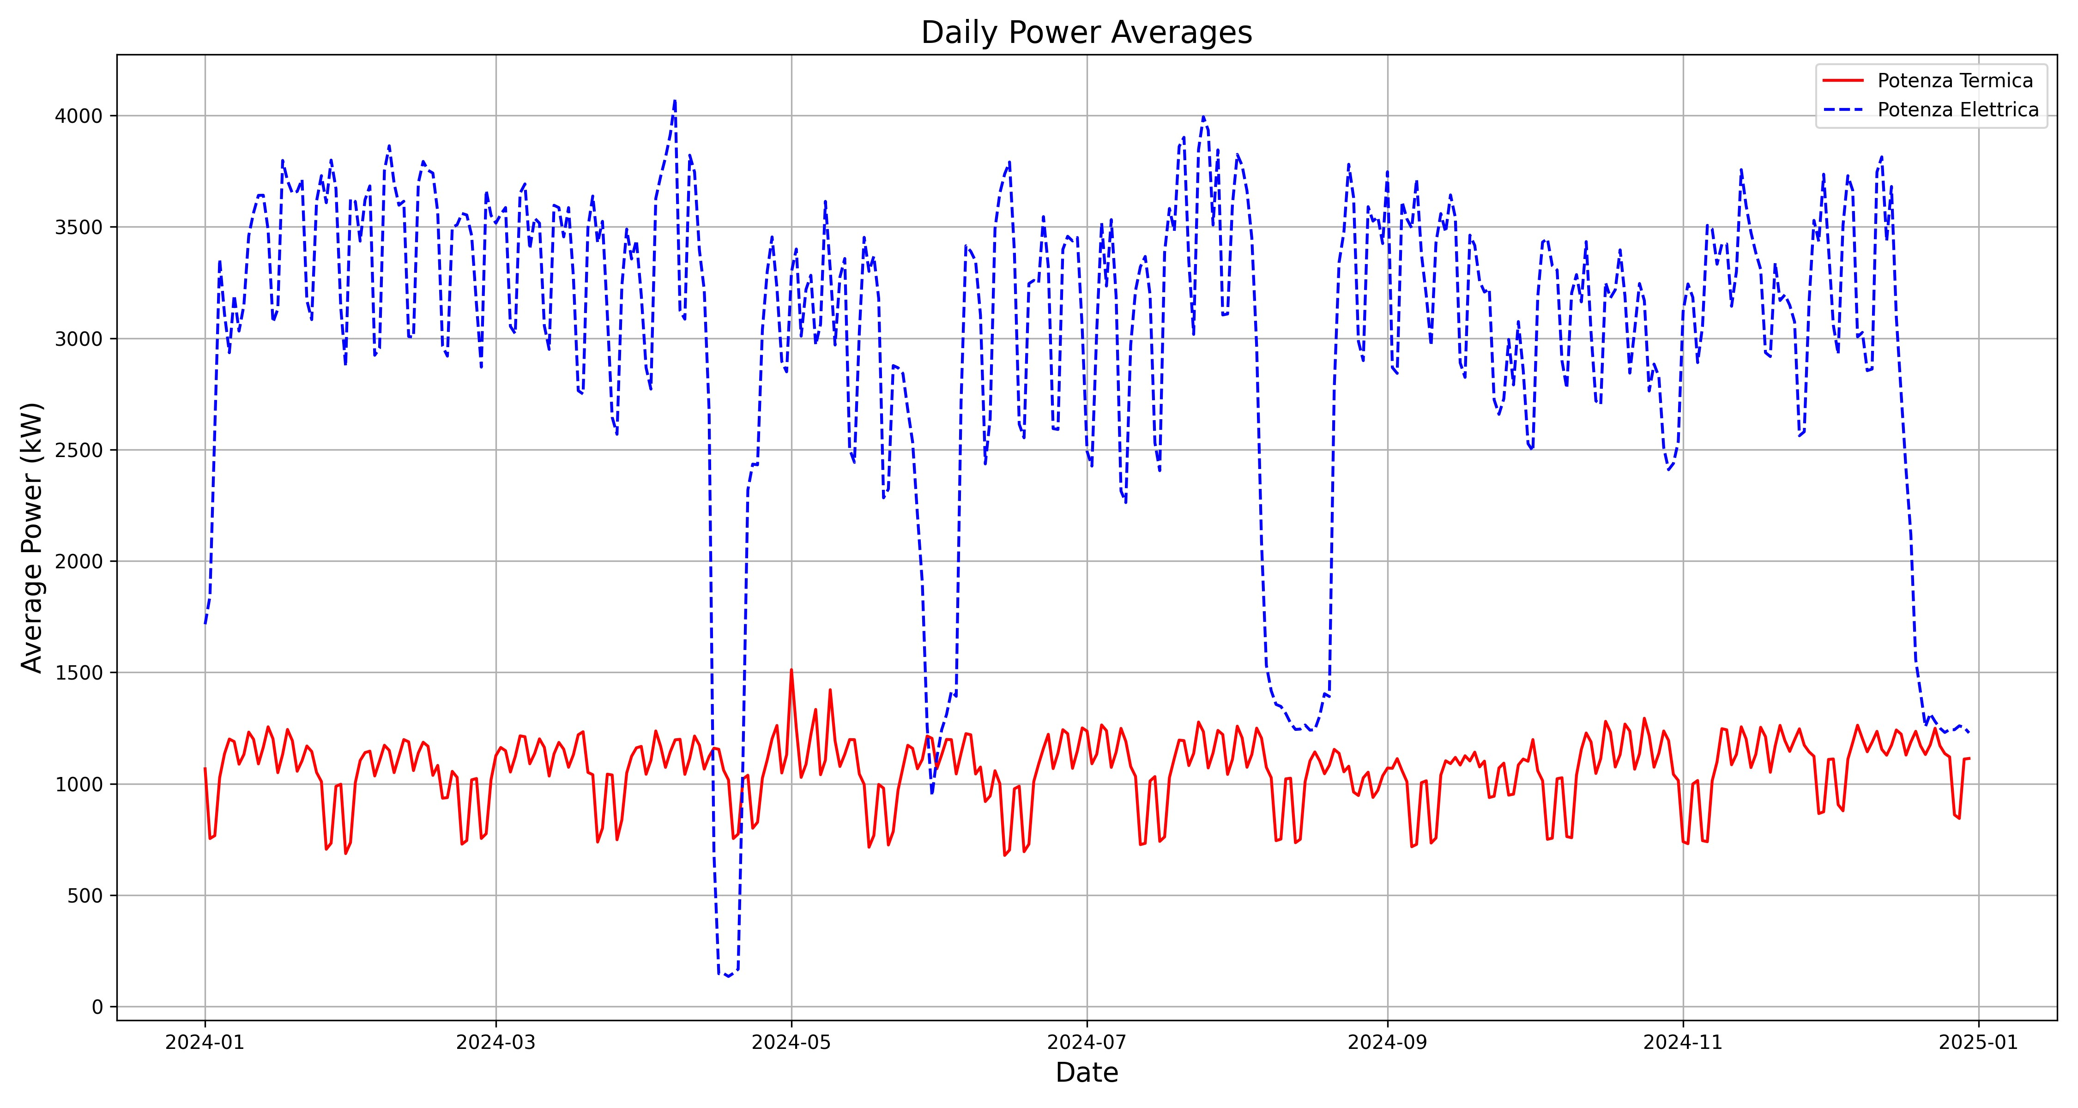
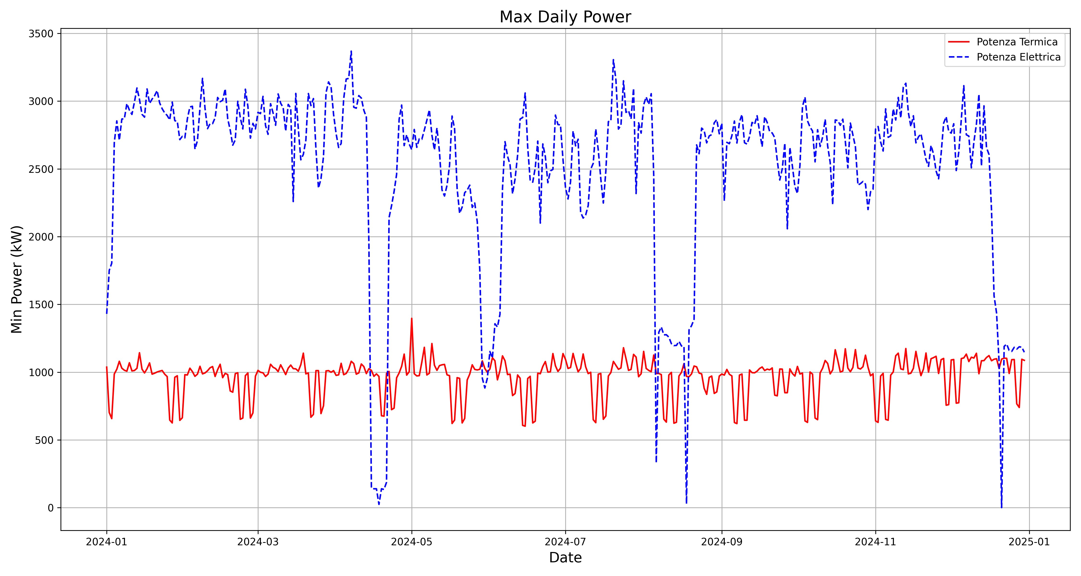
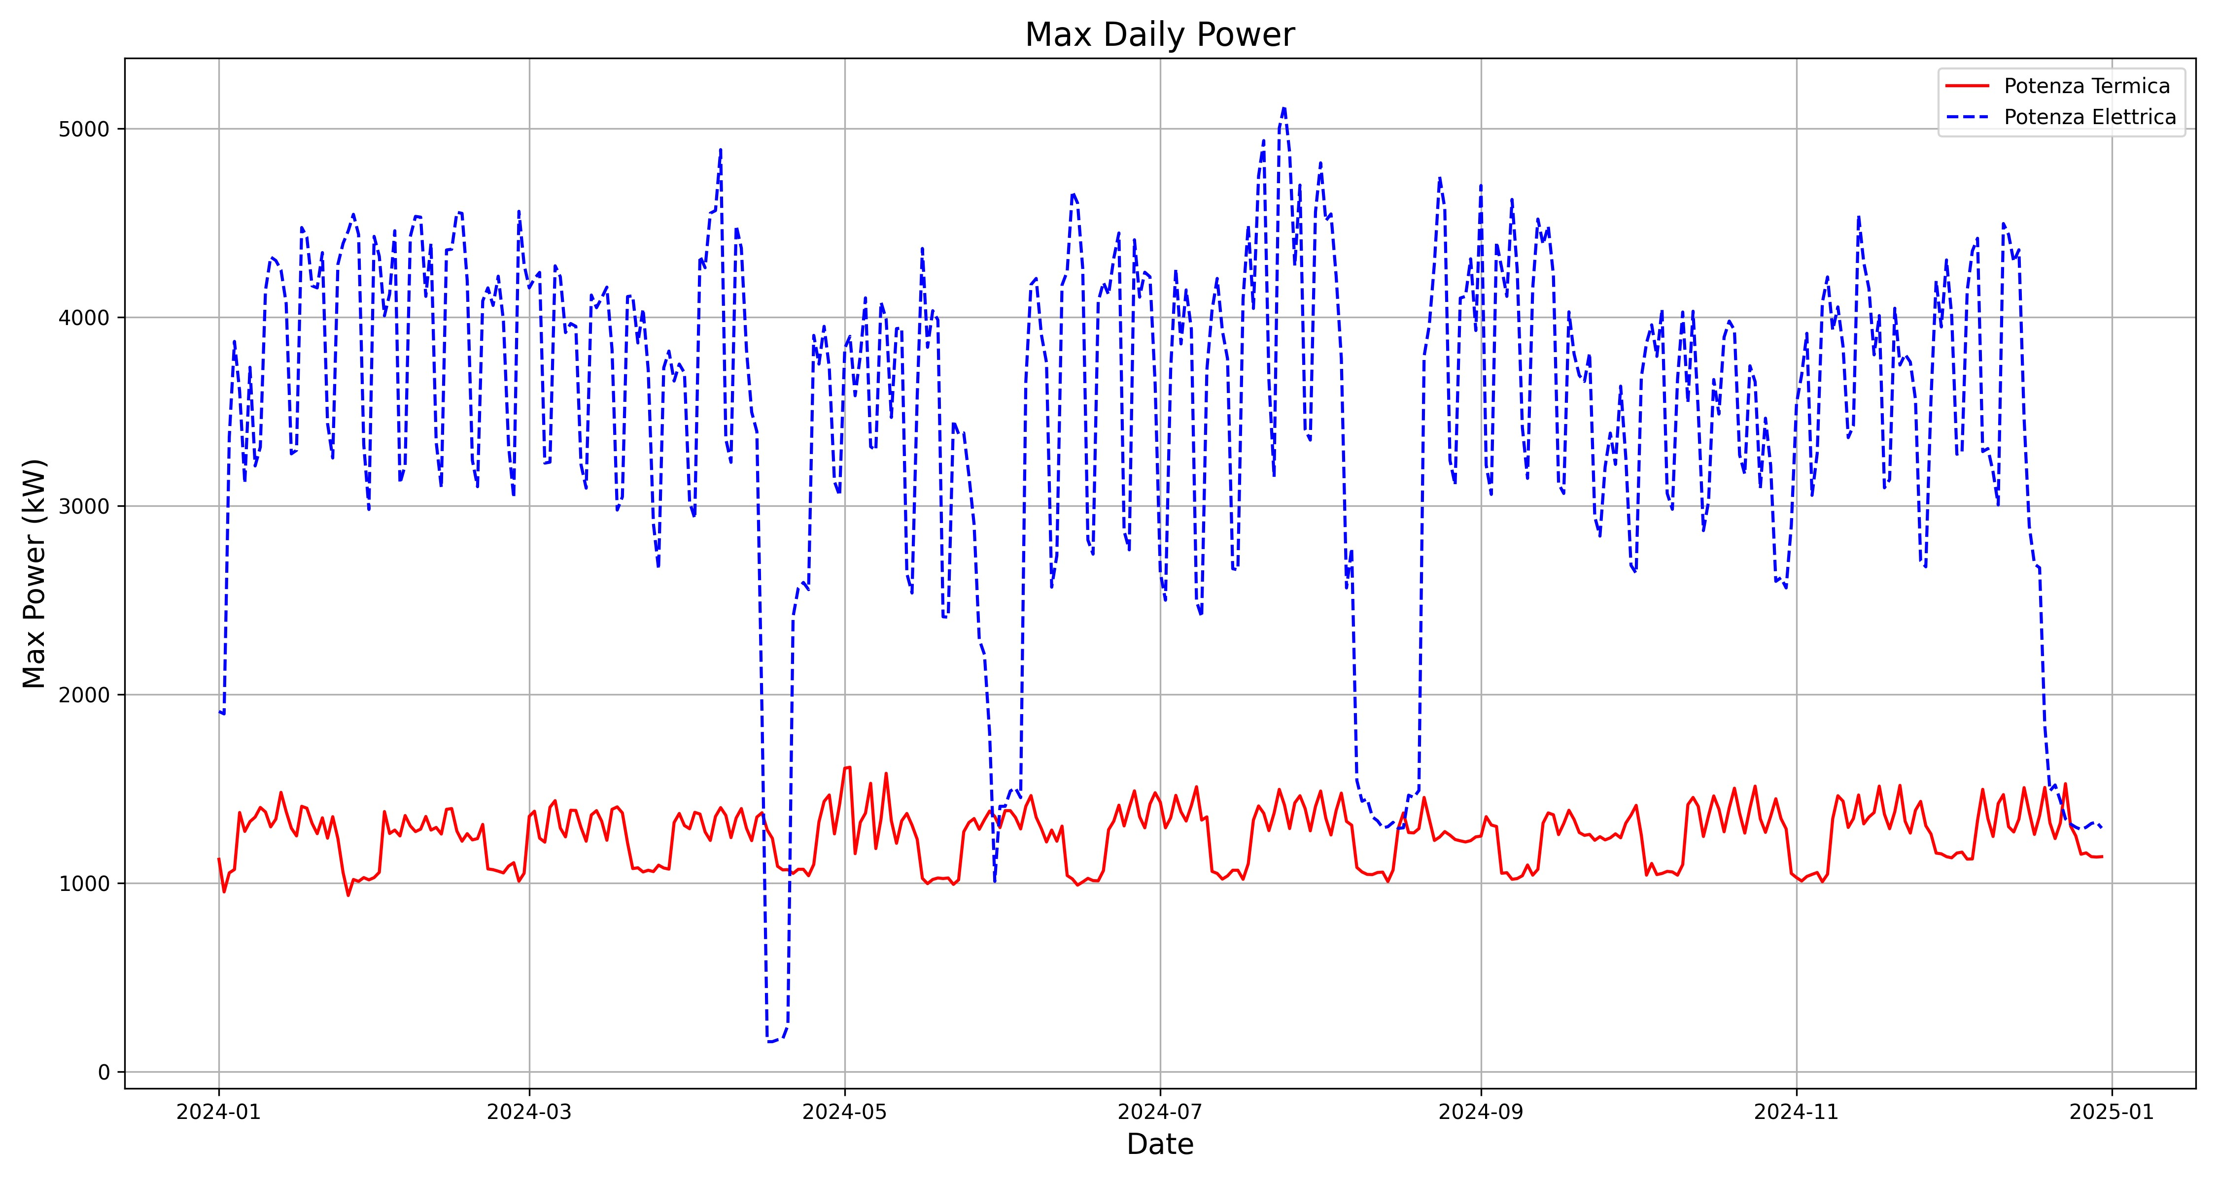
User Load Analysis
Daily averages, minimum, and maximum loads

Slide 7
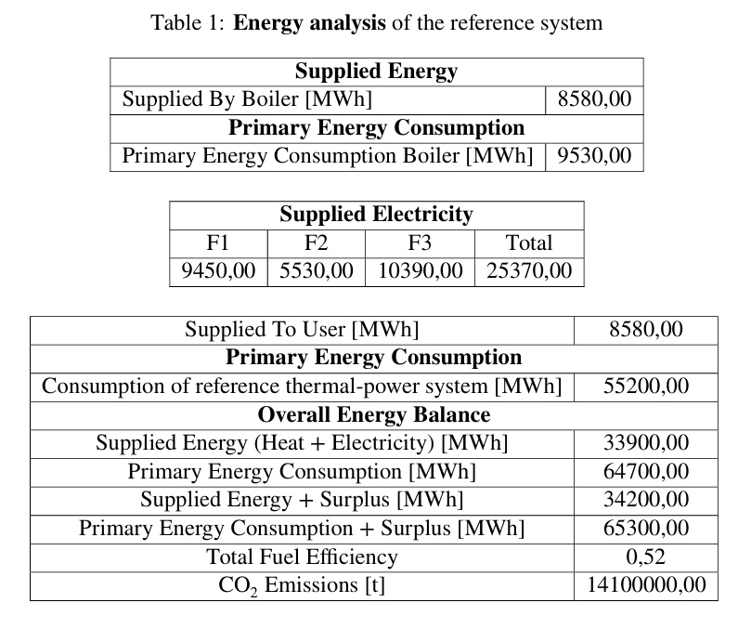
Reference System Description
Current system analysis:
14100

Slide 8
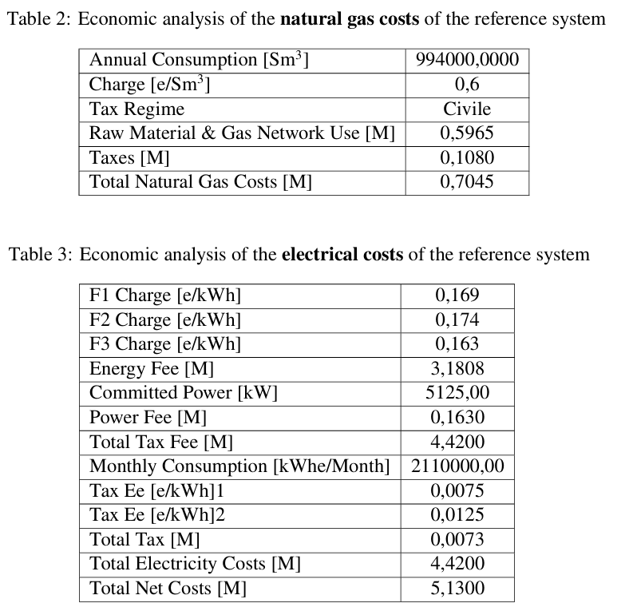
Reference System Description
Current system analysis:

Slide 9
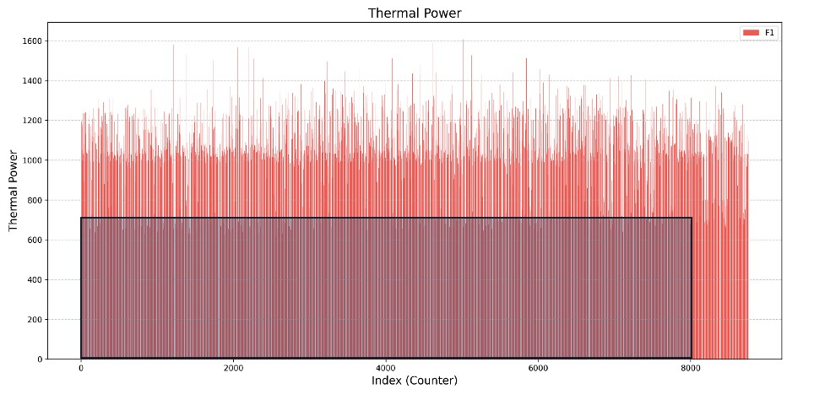
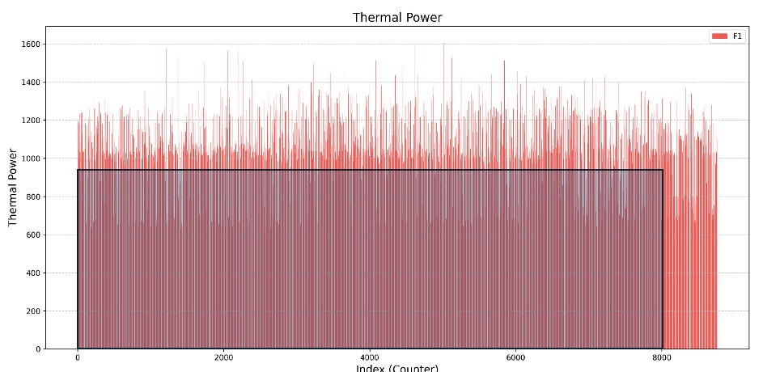
Proposed CHP System
Two CHP solutions analyzed. Solution 2 chosen for better efficiency and cost savings.
Two CHP solutions analyzed:
Solution 1: Jenbacher ICE 312 (600 kW).
Solution 2: Jenbacher ICE 316 (800 kW).

Slide 10
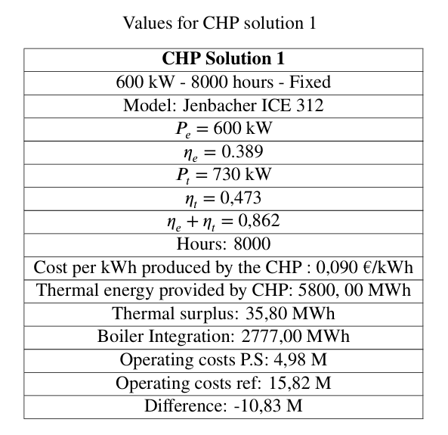
Proposed CHP System
Jenbacher ICE 312

Slide 11
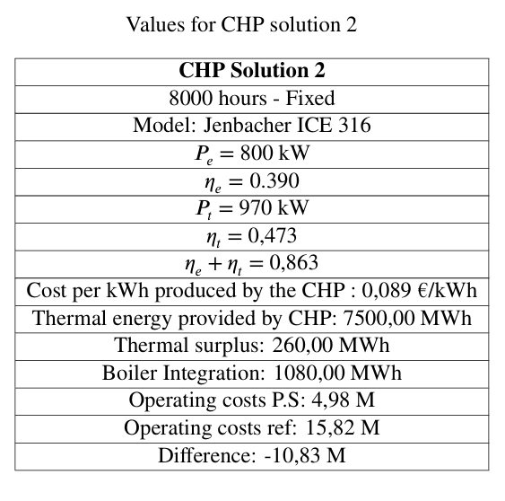
Proposed CHP System
Jenbacher ICE 316

Slide 12
Proposed CHP System
Jenbacher ICE 316

Slide 13
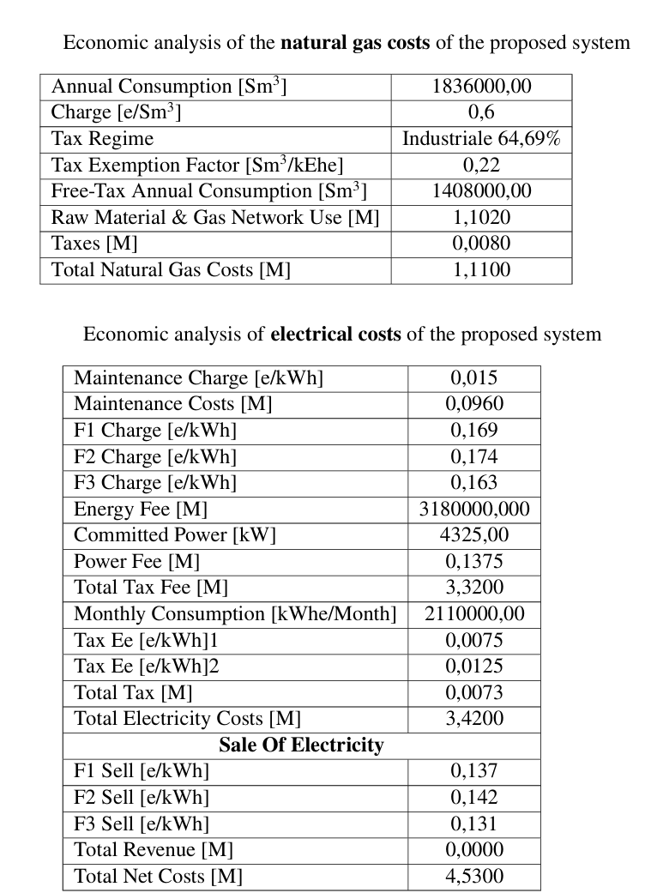
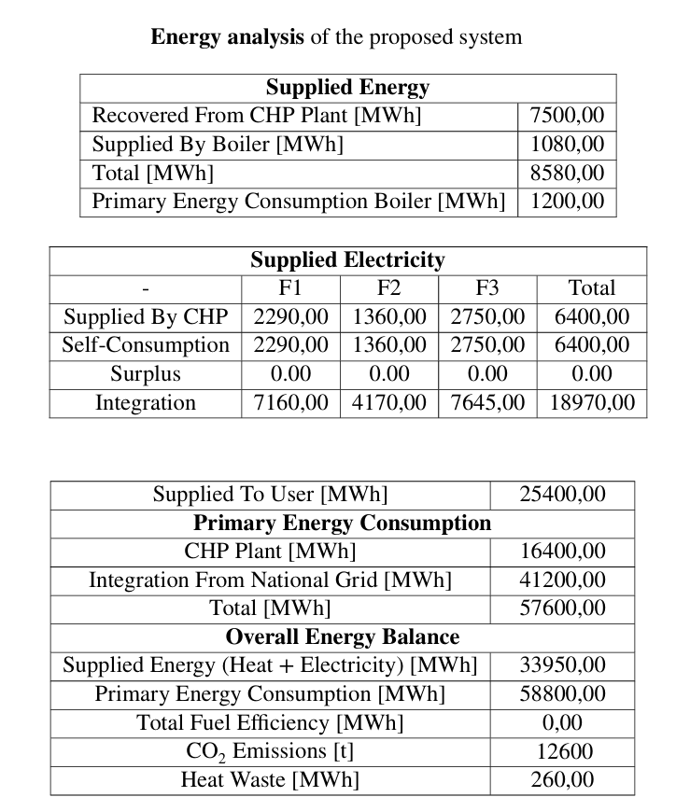
Proposed CHP System

Slide 14
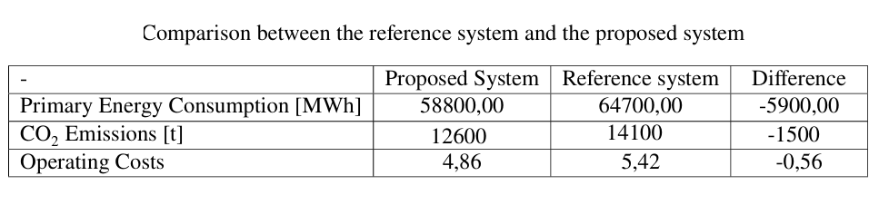
Proposed CHP System
[M]

Slide 15
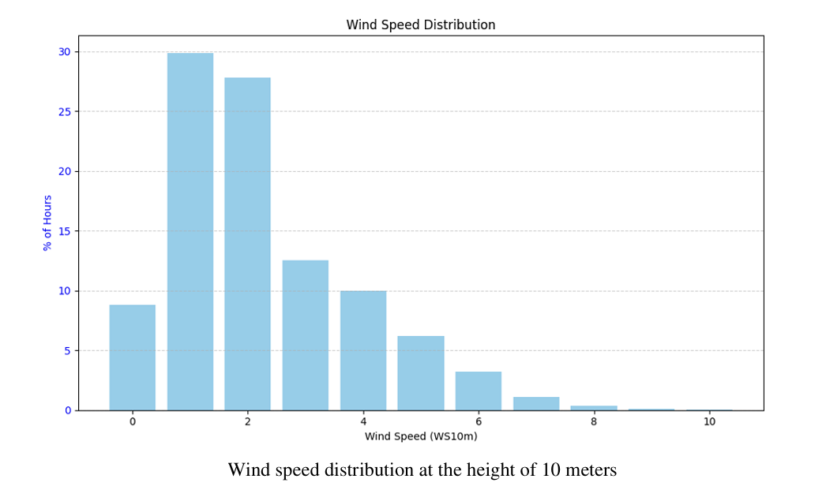
Proposed Wind System
Three wind turbines analyzed:
Wind speed data from Benevento, Italy.

Slide 16
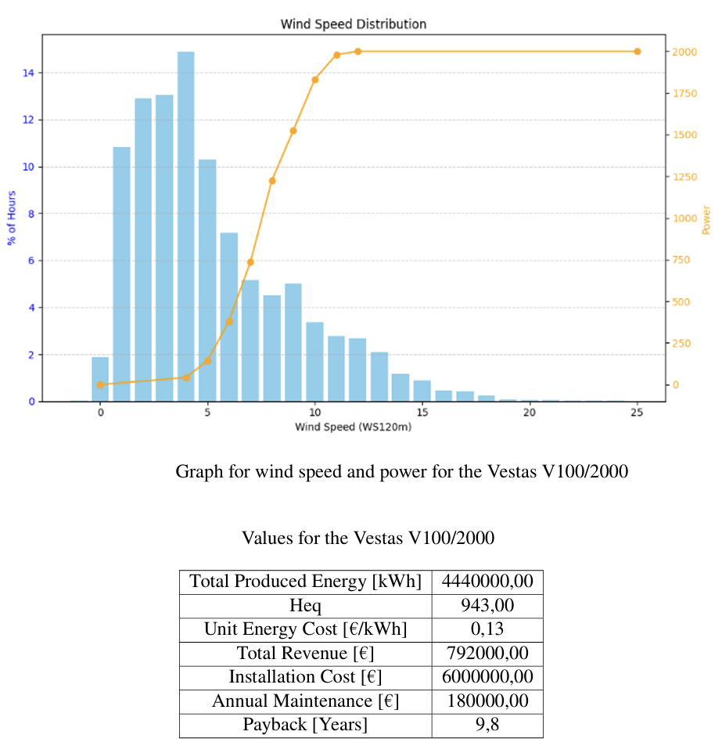
Proposed Wind System
1)

Slide 17
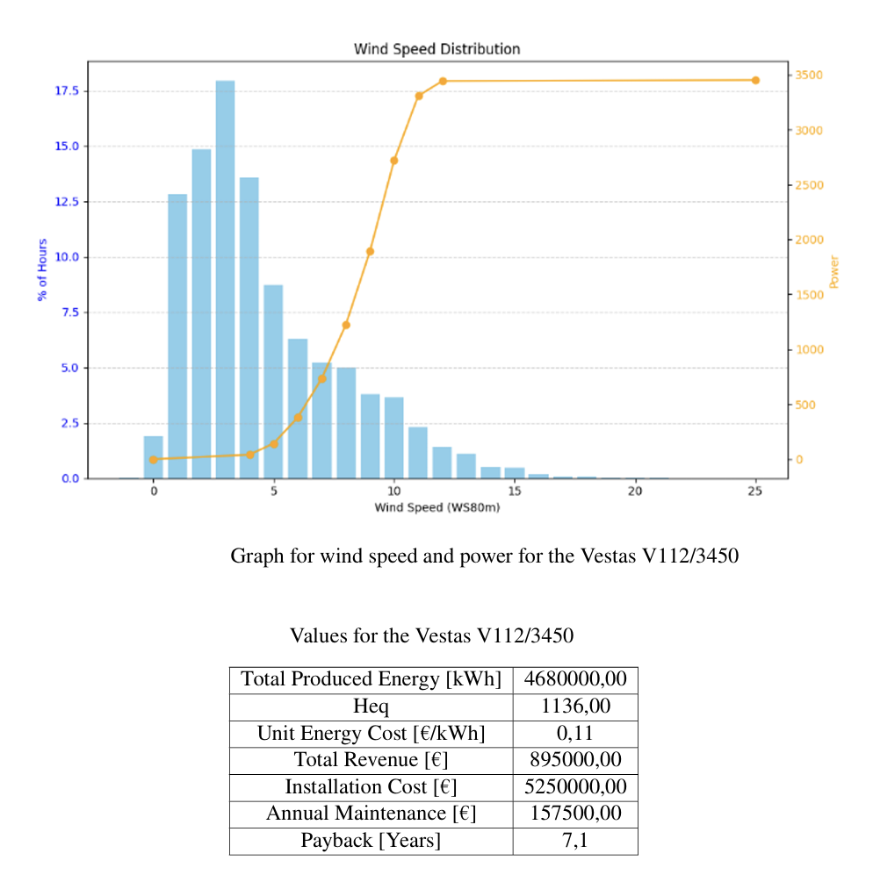
Proposed Wind System
2)

Slide 18
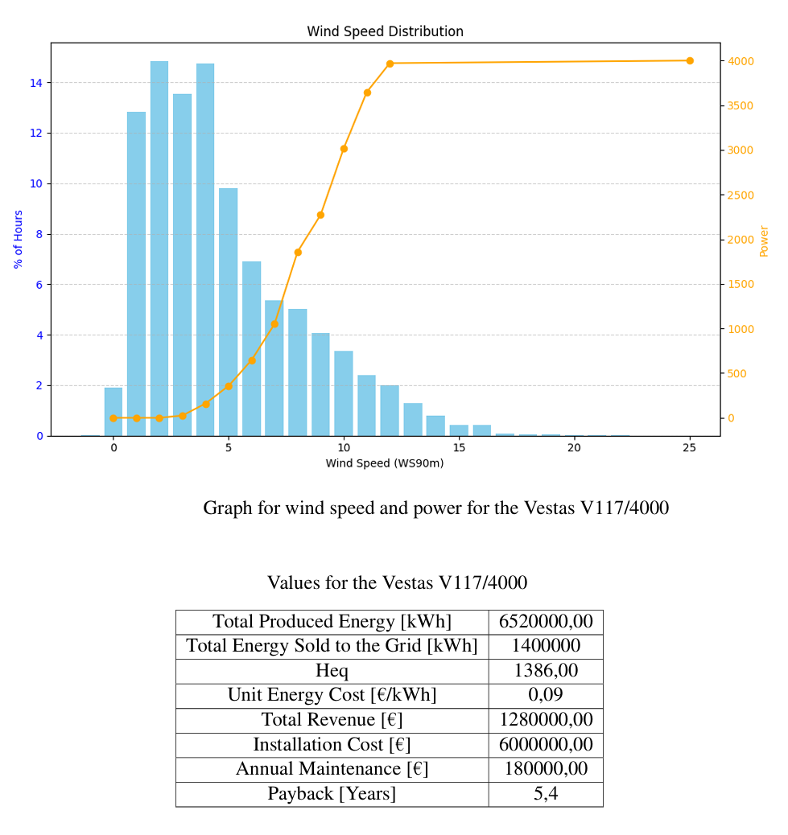
Proposed Wind System
3)

Slide 19
Proposed Wind System
Vestas V117/4000 chosen:
Higher Heq (1386).
Payback time: 5.4 years.
Unit energy cost: €0.09/kWh.
Total revenue: €1.28M.

Slide 20
CHP + Wind
Combination of CHP and wind system optimized for energy savings and cost efficiency.
Jenbacher ICE 316
+
Vestas V117/4000

Slide 21
CHP + Wind
Combination of CHP and wind system optimized for energy savings and cost efficiency.
Jenbacher ICE 316
Results:
Primary energy savings: 18.95%.
CO₂ reductions: 8,723 t.
Total installation costs: €5.65M.
Annual savings: €0.96M.
Payback period: 5.88 years.
Net present value: €6.32M.
Profitability index: 2.12
Internal rate of return: 16.15%.
+
Vestas V117/4000

